Slide 1
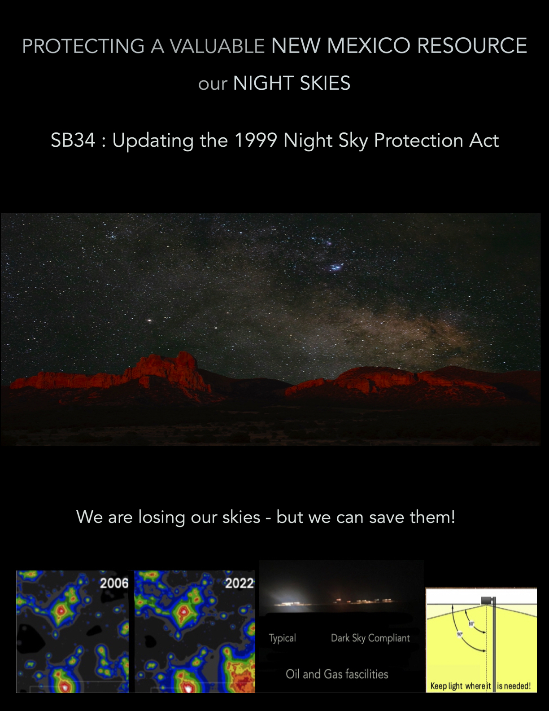
Protecting a valuable New Mexico Resource :
our night skies
SB34 : Updating the 1999 Night Sky Protection Act
2006
2022
Typical;
Dark sky compliant!
Oil and gas facilities

